Slide 1
Ramesh kanna G
DevOps Engineer

Slide 2
Yii 2 basic application deployment
What is Yii 2?
The Yii2 Basic App is a fast, secure, and lightweight PHP framework template designed for developing simple web applications quickly.
What I did?
I containerized a Yii2 Basic PHP application, set up a CI/CD pipeline using GitHub Actions, deployed it to a Docker Swarm cluster, and automated the server setup using Ansible..

Slide 3
Project OVERVIEW
Task
Deploy a sample PHP Yii2 application using Docker Swarm and NGINX (host-based reverse proxy) on an AWS EC2 instance. Automate setup using Ansible and implement CI/CD via GitHub Actions.
TL;DS
“To deploy a Yii2 PHP application using Docker Swarm on AWS EC2 with Ansible-based infrastructure automation and CI/CD via GitHub Actions.”

Slide 4
Tech stacks
Yii 2 is a PHP framework for building web applications with MVC structure and integrated features like security, caching, and testing.
Yii 2 php app
Managed source code version control for the Yii2 application and infrastructure configuration.
git
Source code management platform for version control and collaboration.
github
Used for CI/CD pipeline automation, leveraging GitHub Secrets for secure environment variable management and deployment workflows.
GitHub Action

Slide 5
Tech stacks
Used to containerize the Yii2 PHP application for consistent deployment across environments
Docker
Simplified multi-container orchestration and management for the application and its dependencies.
Docker compose
Enabled container orchestration and scaling on AWS EC2 for high availability.
Docker Swarm
Automated the provisioning of AWS infrastructure, including EC2 instances, security groups, and networking resources.
Terraform

Slide 6
Tech stacks
Configured as a reverse proxy on the host to route traffic to the Yii2 application running in Docker containers.
nginx
Automated the installation and configuration of Docker, NGINX, and other dependencies on the EC2 instance.
ansible
Used to host and run the Docker Swarm cluster and the Yii2 application containers.
Aws ec2
Integrated for monitoring the Docker containers and tracking application performance metrics.
prometheus

Slide 7
Tech stacks
Deployed alongside Prometheus for system-level monitoring of EC2 instance performance.
Node exporter
Used for updating the image name dynamically in the docker-compose.yml file during CI/CD pipelines.
Bash
Stored and managed the Docker images, making them easily accessible for deployments.
Docker Hub
Used for development, debugging, and managing code with extensions and version control integration.
Vs code

Slide 8
prerequisites
Yii 2 BASIC APP SETUP
GIT
GITHUB
GITHUB ACTION [CICD]
DOCKER
DOCKER COMPOSE
DOCKER SWARM
TERRAFORM
NGINX
ANSIBLE, BASH
AWS EC2
PROMETHEUS
NODE EXPORTER
VS CODE [optional]

Slide 9
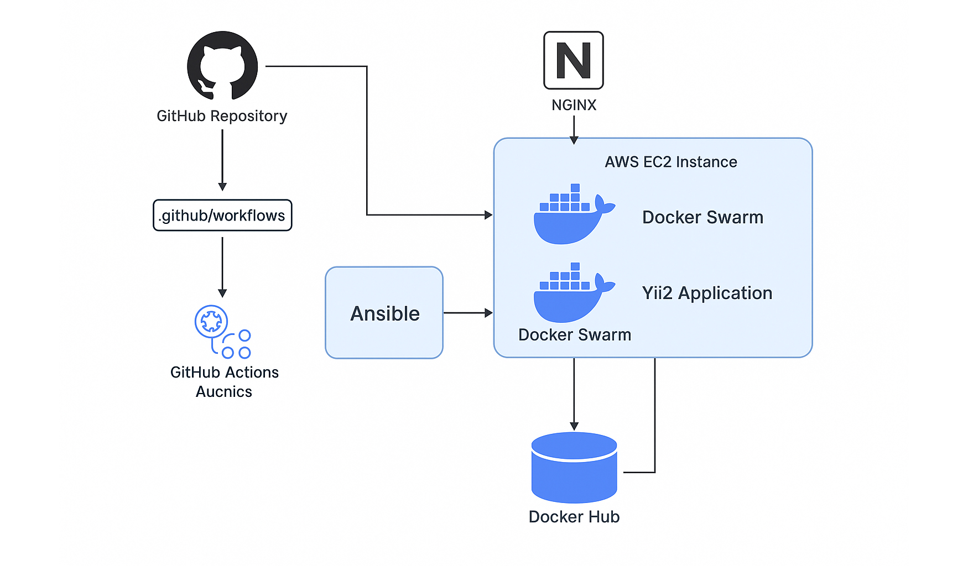
High-Level Architecture

Slide 10
Detailed Steps
10

Slide 11
Ansible configuration Setup
Purpose: Automate setup of a production-ready environment on EC2 for deploying a Dockerized Yii2 application with monitoring and reverse proxy.
Key Components:
Docker: Installed via yum, enabled via systemd, user added to docker group
Docker Compose: Fetched from GitHub Releases (/usr/local/bin, mode 0755)
Docker Swarm: Initialized only if not already active
NGINX: Installed (port 80), started, acts as reverse proxy
Prometheus: Version 2.41.0, listens on port 4545, custom systemd unit
Node Exporter: Version 1.3.1, exposes system metrics on port 9100
Cron Jobs: Ensures all services auto-start at reboot (Docker, NGINX, Prometheus, etc.)
Logic: NGINX receives user HTTP requests on port 80, Routes requests to the Docker Swarm service hosting the Yii2 app
Access the code here: https://github.com/RameshXT/yii2-deployment.git

Slide 12
DOCKER SWARM SETUP
Purpose: Deploy a Yii2 PHP application in Docker Swarm with 2 replicas, health checks, and resource limits.
Key Components:
Service: yii2-app using IMAGE_TAG
Ports: 9090:9090 exposed for HTTP traffic
Replicas: 2 (high availability)
Healthcheck: Curl on localhost:9090, retries 3x
Resources:
Limit: 0.5 CPU, 512MB RAM
Reservation: 0.25 CPU, 256MB RAM
Environment: Production mode (APP_ENV, APP_DEBUG)
Logging: 10MB max per file, 3 log files
Volume: app-data mapped to /var/www/html
Traffic Flow: NGINX receives external traffic → Forwards to service on port 9090 → Docker Swarm load-balances across 2 app replicas → Healthchecks ensure only healthy containers serve requests.
Access the code here: https://github.com/RameshXT/yii2-deployment.git
12

Slide 13
CIDCD – GITHUB ACTIONS SETUP
Purpose: Automate the deployment of the Yii2 application, including build, push to Docker Hub, and deploy using Docker Swarm.
Key Components:
Checkout Code: Retrieves the latest code from the repository
Setup Python & Ansible: Installs required tools for EC2 configuration
Set up SSH: Configures secure SSH access to EC2
Run Ansible Playbooks: Configures EC2 and sets up reverse proxy using Ansible
Docker Buildx Setup: Prepares Docker Buildx for multi-platform support
Docker Hub Authentication: Logs in to Docker Hub with stored secrets
Build & Push Docker Image: Builds the Docker image and pushes it to Docker Hub with a unique version tag
SSH into EC2 & Deploy: Deploys the updated Docker image on EC2 using Docker Swarm, including image tag update and stack deployment
Logic: Code pushed to GitHub triggers the pipeline → Docker image is built & pushed → EC2 is configured and deployed with the new image via Docker Swarm → Application is accessible via EC2 IP.
Access the code here: https://github.com/RameshXT/yii2-deployment.git
13

Slide 14
Docker Image Optimization
3 minutes
255 mB
low
Build Time
Image Size
Performance
Before – dockerfile

Slide 15
Docker Image Optimization
30 seconds
55
mB
high
Build Time
Image Size
Performance
After – multi stage dockerfile

Slide 16
Demo
Once the Yii2 application is successfully deployed, it becomes fully operational.
You can interact with the app through the web interface, where users can access the application via the NGINX reverse proxy.
The application is now ready for production use, and you can integrate it with additional services or modify it as needed.

Slide 17
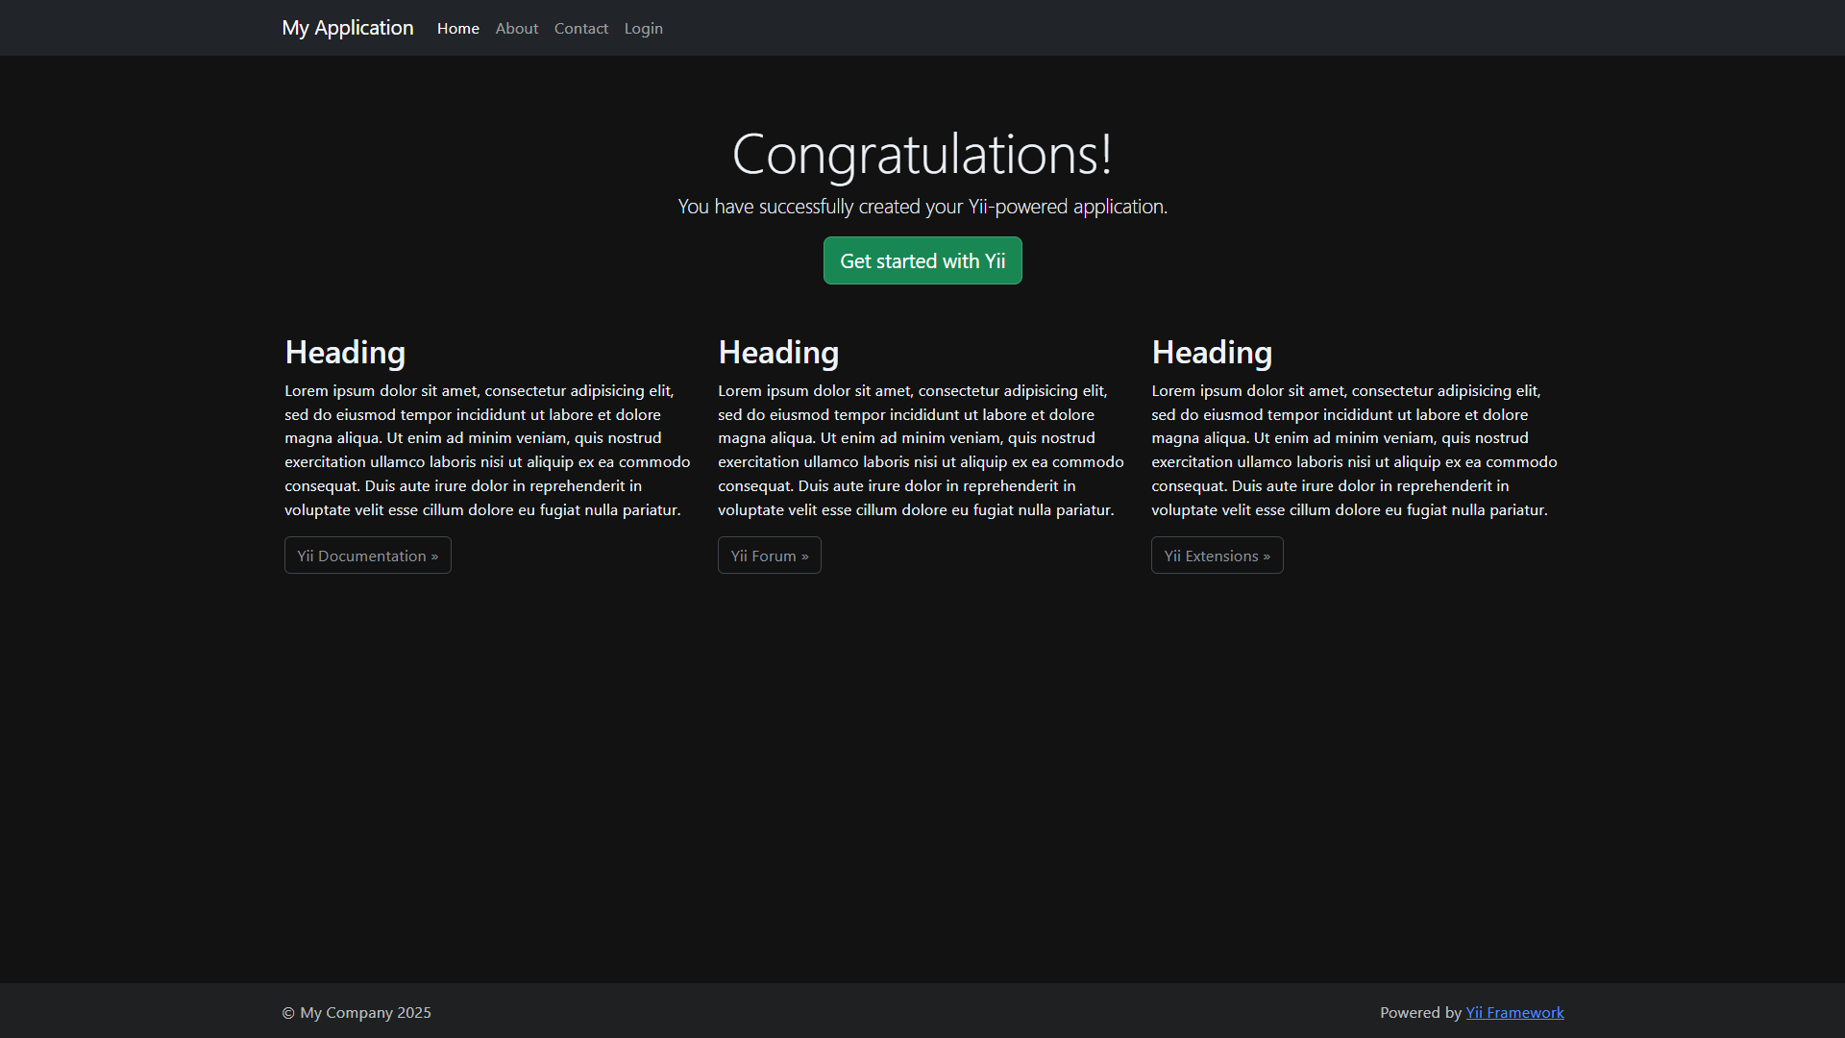

Slide 18
Conclusion
Successfully deployed a scalable Yii2 application using Docker, Docker Swarm, Ansible, Nginx GitHub Actions, and AWS.
This project demonstrates a fully automated CI/CD pipeline, containerized application deployment, and efficient management using modern DevOps practices.

Slide 19
THANK YOU
Ramesh Kanna G​
+91 94424 03868
rameshkanna841@gmail.com
https://rameshxt.pages.dev

